Slide 1
ANALYSIS OF AMAZON PRIME VIDEO
KARTHIKA A

Slide 2
OVERVIEW
.
Amazon Prime Video is a popular streaming service offering a vast collection of movies, TV shows, documentaries, and original content produced by Amazon. Available globally, it provides both
subscription-based and rental/purchase options for viewers. The platform features a diverse range of content spanning various genres, languages, and countries, catering to a wide audience.

Slide 3
Overview of dataset
The dataset contains detailed information about the content available on Amazon Prime Video.
It includes attributes such as:
show_id: Unique identifier for each title.
type: Indicates whether the title is a movie or a TV show.
title: The name of the title.
director: The director(s) of the title.
cast: The main cast members.
country: The country of origin.
date_added: The date the title was added to the platform.
release_year: The year the title was released.
rating: The maturity rating of the title.
duration: The duration of the movie or TV show.
listed_in: The genres the title belongs to.
description: A brief description of the title.
The dataset consists of 9668 entries with these 12 columns, offering a rich source of
information for analysis.

Slide 4
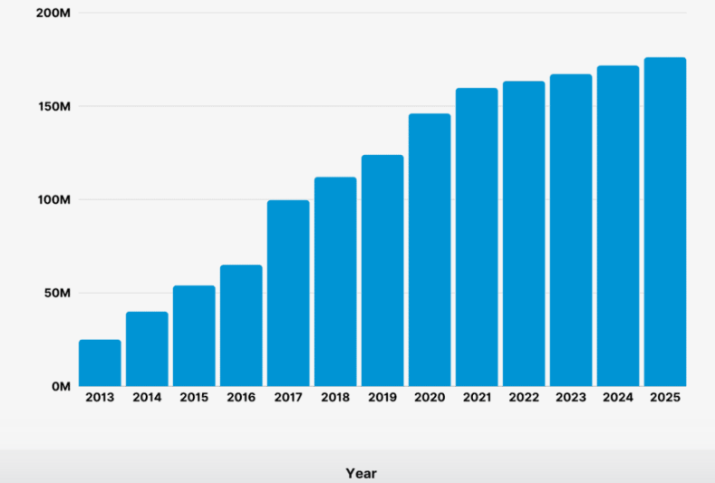
Analyze Trends Over Time
Examine the distribution of release years to identify
trends and patterns in content production over time.
Investigate Exam the popularity and prevalence
of different genres across different years.

Slide 5
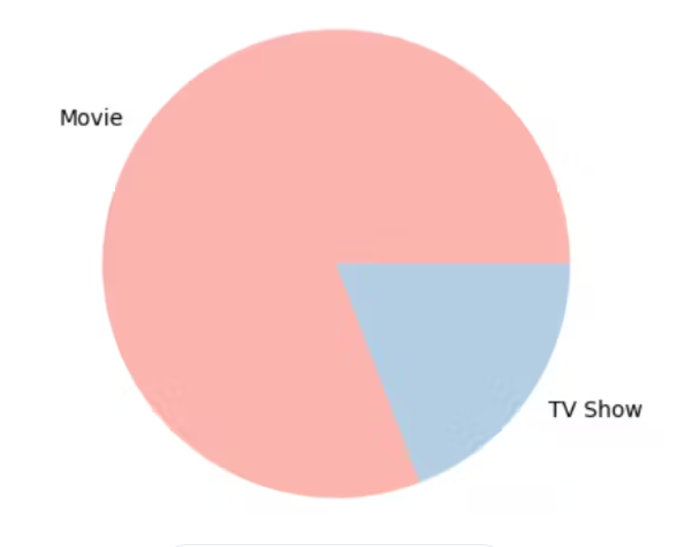
Content Duration Analysis
Analyze the distribution of content duration to understand typical
lengths of movies and TV shows.
Identify any outliers or unusual duration patterns.

Slide 6
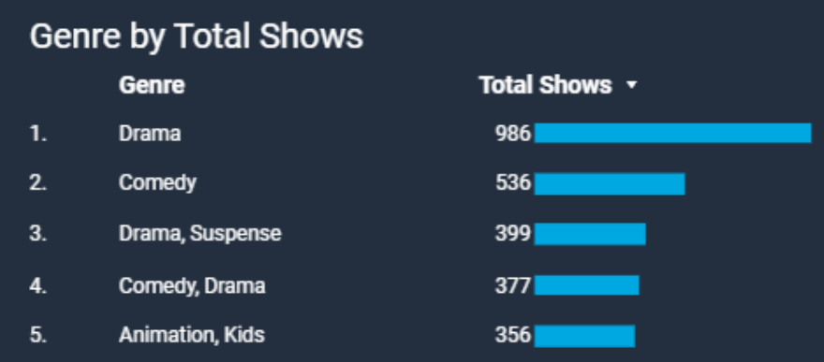
GENRE POPULARITY
Explore the most common genres and their prevalence in the dataset.
Analyze trends in genre popularity over time.

Slide 7
GEOGRAPHICAL DISTRIBUTION
Examine the distribution of content across different countries.
Identify which countries contribute the most content to Amazon Prime Video.

Slide 8
CORRELATION ANALYSIS
Investigate correlations between numerical attributes such as release year and duration.
Identify any significant relationships between different variables.

Slide 9
CONCLUSION
Amazon Prime Video has emerged as a dominant player in the streaming industry, offering a vast library of movies, TV shows, and original content. With its global reach, Prime Video has successfully expanded its subscriber base, competing with other major streaming platforms like Netflix and Hulu. Its diverse content offerings cater to a wide range of audiences, from blockbuster hits to niche genres. Furthermore, the platform's integration with other Amazon services, such as Prime delivery and Prime Music, enhances its value proposition for subscribers. Overall, Amazon Prime Video continues to be a formidable force in the streaming landscape, continually evolving and innovating to meet the demands of today's entertainment consumers.

